Slide 1

THE MAHARAJA SAYAJIRAO UNIVERSITY OF BARODA
FACULTY OF SCIENCE
DEPARTMENT OF STATISTICS
Project Title:
A Distributorship Analysis Of
FMCG(Unibic) Products In
Vadodara
Presented By:
Mohammad Saeed
Ravikumar Rathva
Sujit Raval
Guided By:
Mr. Shrey Pandya
Meenakshi Porwal
Srushti Sali
Mona Shah

Slide 2

Contents
Aim of the Project
About the Client
Objectives of the Study
Preliminary information
Data processing methodology
Data Visualizations
Statistical Techniques
Unpaired Two Sample T test Analysis
RFM Analysis
K Means Clustering
Conclusions
References

Slide 3
Why this Project?
AIM:
To understand distributor-to-retailer business, and apply the statistical knowledge for a distributorship company to discover meaningful insights for different categories of Unibic products.

Slide 4





Who is A Distributor?
PRODUCERS
Organizations that make products or service
DISTRIBUTORS
Companies that take inventory in bulk from producers
RETAILERS
Stock inventory
CONSUMERS
Individuals that purchase and use a product or service
Producers of raw materials and producers of finished goods
Sell products in larger quantities
Sell in smaller quantities to customers in the general public
Depend on producers, distributors, and retailers to meet their needs for products

Slide 5


What is FMCG?
Fast-moving consumer goods (FMCG), refer to products that are highly in-demand, non durable, sold quickly, affordable and have short shelf life.
FMCG sector is the 4th largest sector of the Indian economy.
Some of the top FMCG companies in India are- Dabur (60%), Colgate (54.7%), Hindustan Unilever (54%).

Slide 6

About Agency
CLIENT: PREM AGENCIES (UDYAM-GJ-24-0009250)
Food products supplier in Vadodara
Vadodara Distributor Association(VDA) member
GST Audited reports (GSTIN 24AHDPR7310N1Z5)

Slide 7
Objectives
To utilize the past years data to identify trend and envision the sales for the upcoming year.
We have data for three financial years, however, the data for the last financial is not complete (two months).
We utilize the past data to envision an increase in sales for the same.
The study also includes a quarter-wise comparison of sales for these financial years.
2. To classify SKUs of Unibic products into different categories and analyze them.
Identifying the Top performing Product, Categories along with products in particular categories.
3. To compare supplies of Unibic products in different stores diversified over several areas in Vadodara.
Identify to Top performing Areas based on the purchasing behavior of customers in those particular areas

Slide 8
Objectives
4. To compare the sales of two years and identify the factors contributing to the difference.
Observing how secondary variables affect the sales of the distributor, and studying their influence.
5. To segment retailers based on their purchasing behavior.
To identify Loyal Customers, At risk of leaving customers, and Lost customers based on after analysing their purchasing behaviour.

Slide 9
Preliminary Information
Data Dimension of Combined Data: 14507 × 15

Slide 10
Data Processing Methodology
Raw Data
Sales data
Data Cleaning
Dealing with Missing Values
SKU Mapping
Eliminating unrequired data
Transformed Data
Merging raw and secondary data
Transforming data into different data files
Secondary Data
Temperature
Stores Mapping
Rainfall
Festivals

Slide 11
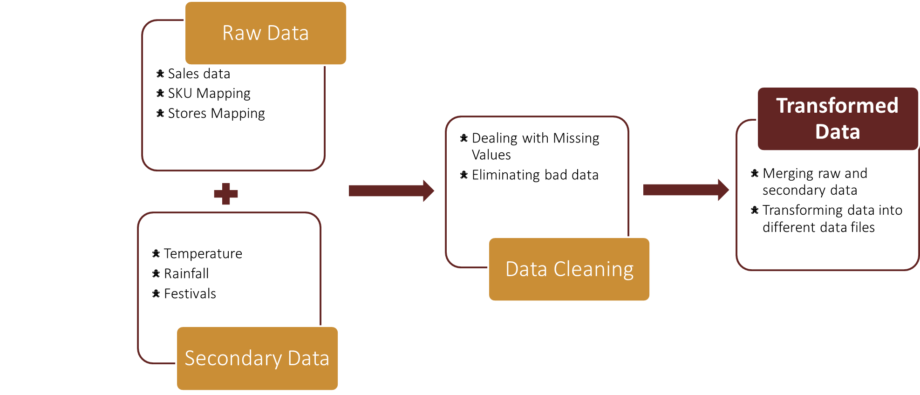

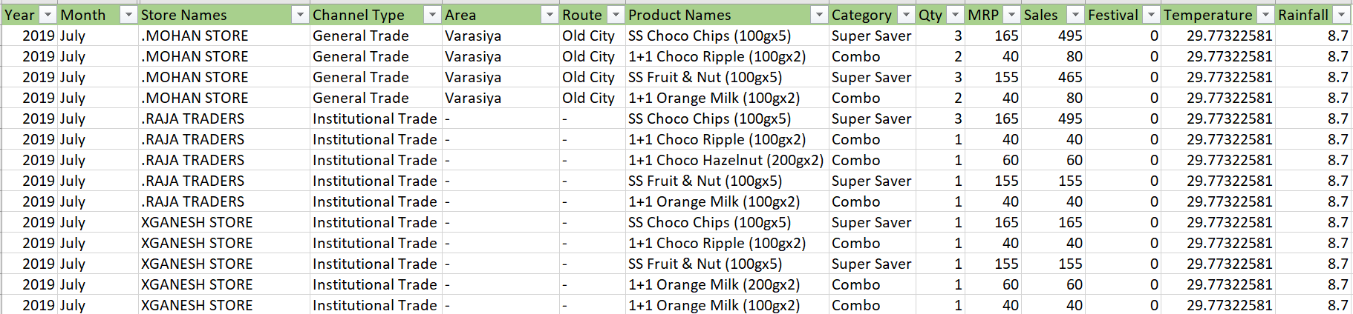
Transformed Data
1. Combined Data

Slide 12
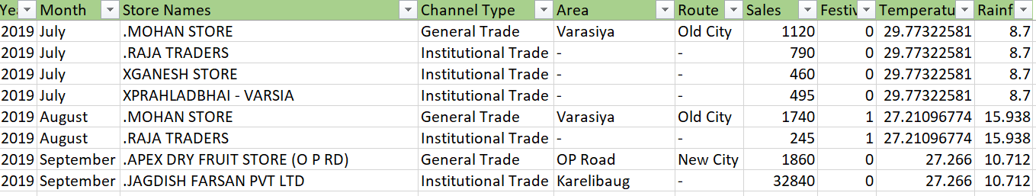
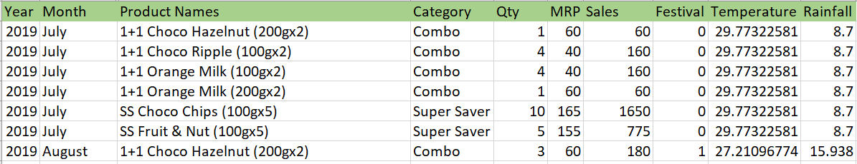
Transformed Data
2. Data By Stores
3. Data By Products

Slide 13
Data
Visualization

Slide 14
Overall Sales
*For the year 2019 data was received from July onwards.

Slide 15
Year wise Distribution of Stores

Slide 16
Sales of Top 5 Stores

Slide 17
Category wise Sales

Slide 18
Sales by Channel Type

Slide 19
Sales of Top Ten Products in Channels

Slide 20
Unpaired Two Sample T-Test

Slide 21
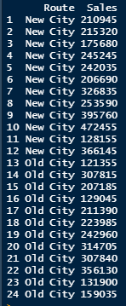
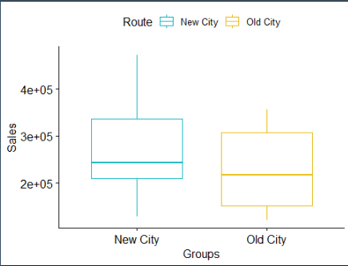
Unpaired Two Sample T-Test
1) Significance difference between Sales in New city and Old city routes
From the box plot : we can see that the average sales of both the routes is almost similar

Slide 22
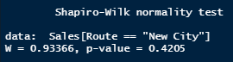
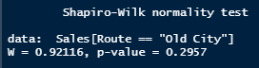
Shapiro-Wilk normality test
Hypothesis : -
H0 : Data is normally distributed. Vs. H1 : Data is not normally distributed.
with(data, shapiro.test(Sales[Route == "New City"]))
with(data, shapiro.test(Sales[Route == "Old City"]))
Interpretation :
From the output, we observe that the p-values are greater than the significance level 0.05, implying
that the distribution of the data is normally distributed. In other words, we can assume the normality.

Slide 23
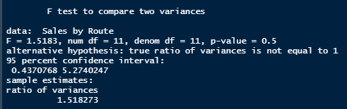
F-test for Homogeneity of Variances
Hypothesis :
H0 : there is no significant difference between the variances of the two sets of data. Vs.
H1 : there is significant difference between the variances of the two sets of data.
res.ftest <- var.test(Sales ~ Route, data = data)
Interpretation :
The p-value of F-test is p = 0.1713 which is greater than the significance level 0.05.
Hence we can conclude that, there is no significant difference between the variances of the two sets of
data. Therefore, we can use the classic t-test which assume equality of the two variances.

Slide 24
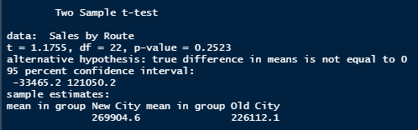
T- test
Hypothesis :
H0 : there is no significant difference between the Sales of the two sets of data. Vs.
H1 : there is significant difference between the Sales of the two sets of data.
res <- t.test(Sales ~ Route, data = data, var.equal = TRUE)
Interpretation :
The p-value of the test p = 0.2523, which is greater than the significance level 0.05.
We can conclude that average sales through New city's route is not significantly different from Sales
through old city's route at 5% level of confidence.

Slide 25
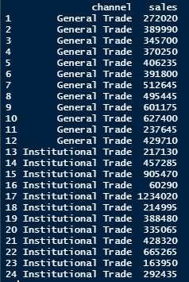
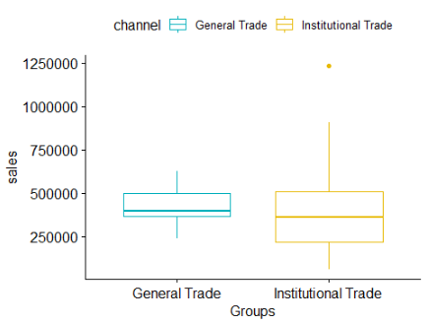
Unpaired Two Sample T-Test
2) Significance difference between Institutional Trade and General Trade Sales
From the box plot : we can see that the average sales of both the trades is almost similar

Slide 26
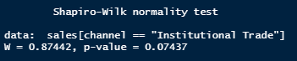
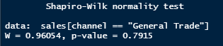
Shapiro-Wilk normality test
Hypothesis : -
H0 : Data is normally distributed. Vs. H1 : Data is not normally distributed.
with(data, shapiro.test(sales[channel == "Institutional Trade"]))
with(data, shapiro.test(sales[channel == "General Trade"]))
Interpretation :
From the output, we observe that the p-values are greater than the significance level 0.05, implying that the distribution of the data is normally distributed. In other words, we can assume the normality.

Slide 27
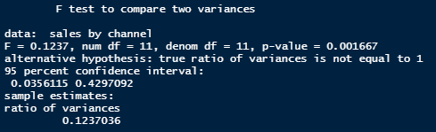
F-test for Homogeneity of Variances
Hypothesis :
H0 : there is no significant difference between the variances of the two sets of data. Vs.
H1 : there is significant difference between the variances of the two sets of data.
res.ftest <- var.test(sales ~ channel, data = data)
Interpretation :
The p-value of F-test is p = 0.0016 which is less than the significance level 0.05.
Hence we conclude that there is significant difference between the variances of the two sets of data.
Therefore, we can use the welch t-test which assume inequality of the two variances.

Slide 28
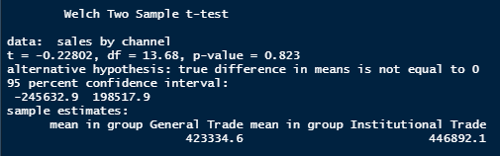
T- test
Hypothesis :
H0 : there is no significant difference between the Sales of the two sets of data. Vs.
H1 : there is significant difference between the Sales of the two sets of data.
res <- t.test(sales ~ channel, data = data, var.equal = FALSE)
Interpretation :
The p-value of the T-test p = 0.823, which is greater than the significance level 0.05.
We can conclude that Institutional Trade's Sales is not significantly different from General Trade's Sales
with 5% level of confidence.

Slide 29
RFM ANALYSIS

Slide 30


What is RFM Analysis?
RFM indices help in the formation of customer segments.
Customer segmentation is the process of identifying a group of customers who share similar characteristics.
Recency (R):
The number of days or months since the last purchase was made by a customer.
Frequency (F): The number
of purchases
in a certain
time period.
Monetary Value (M):
The total amount of money spent by a customer during a specific period of time.

Slide 31
RFM Variables in our Data
Customers: Different Stores to which the UNIBIC products are distributed by Prem Agencies.
Recency: When was the last purchase of a store?
Number of months since the last purchase
Frequency: How frequently does the store purchase from the distributor?
Frequency of purchase of a store, i.e., how many times in the period of 31 months the store has purchased products.
Monetary Value: How much has the store spent?
Total sales of a store.

Slide 32
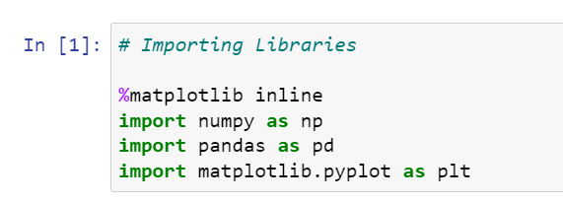
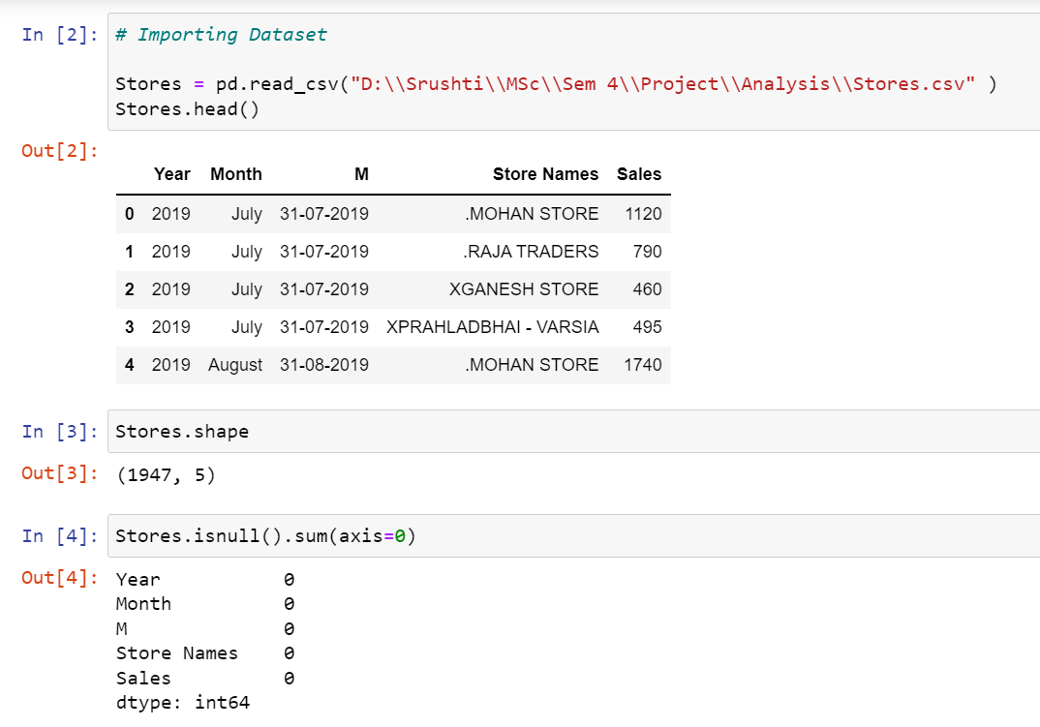
Initial Steps
Step 1: Importing necessary libraries
Step 2: Importing data from CSV file
The column M needs to be converted to a datetime format for the ease of performing operations on dates.

Slide 33
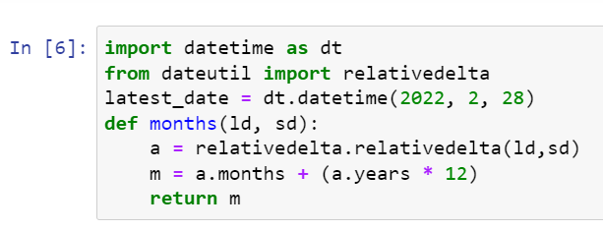
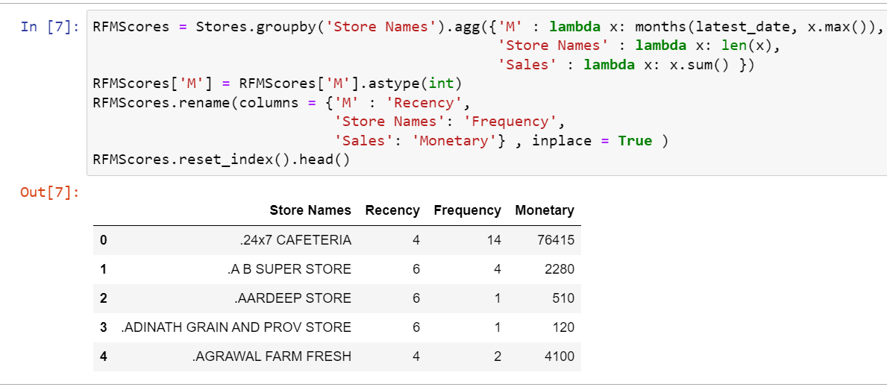
Calculating RFM Variables Values
To calculate the Recency in this way, a function “ month “ is defined, where the arguments are two dates. This function calculates the number of months between the provided two dates and then calculate the RFM values.

Slide 34
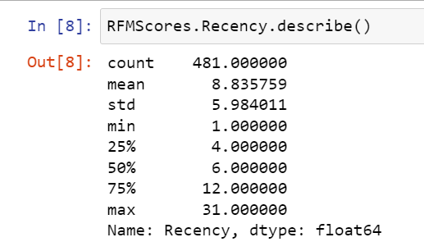
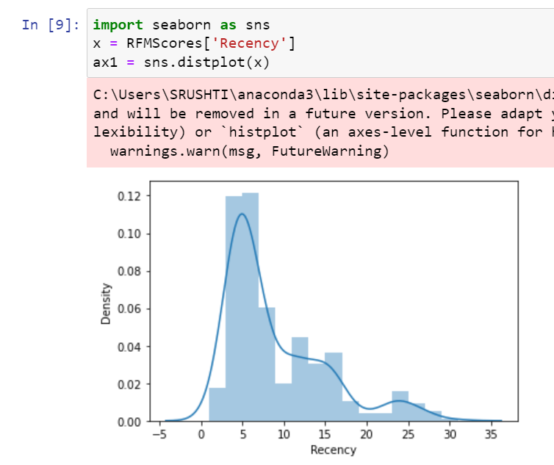
Descriptive Statistics of Recency, Frequency and Monetary value
Recency

Slide 35
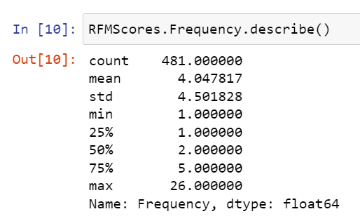
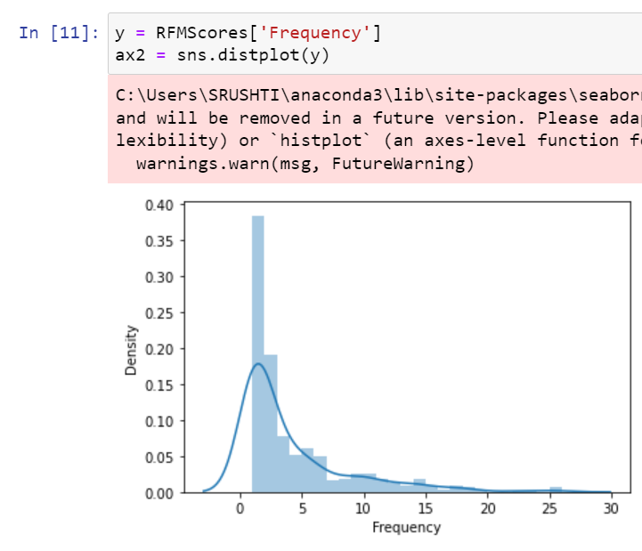
Frequency

Slide 36
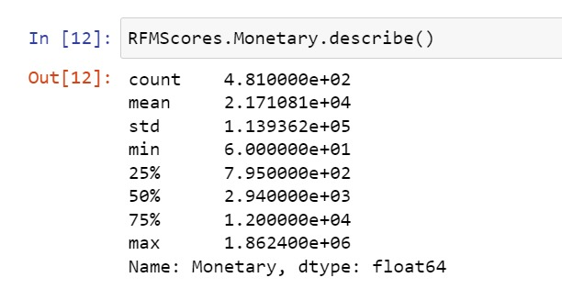
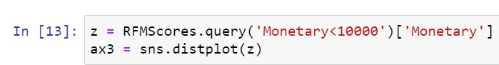
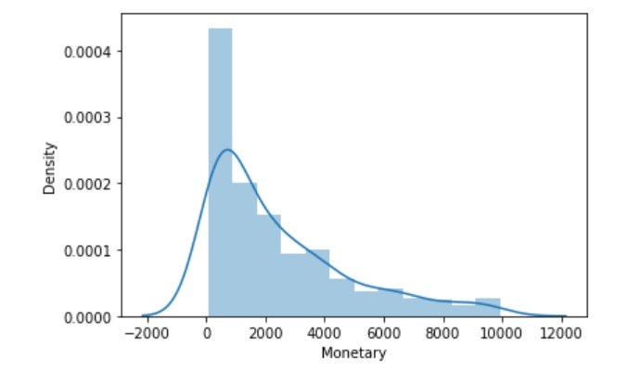
Monetary Value

Slide 37
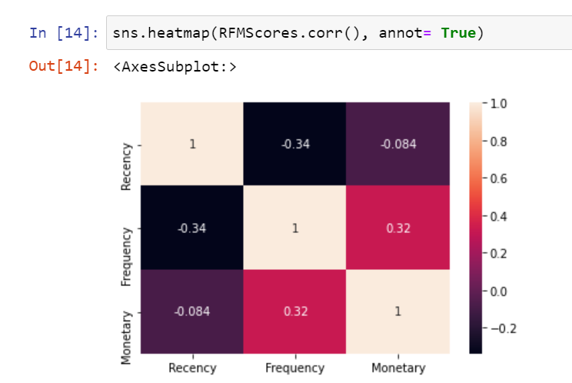
Heatmap of RFM Variables
.

Slide 38
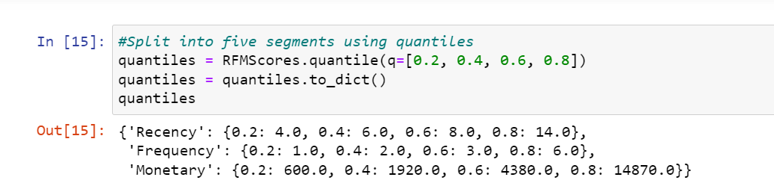
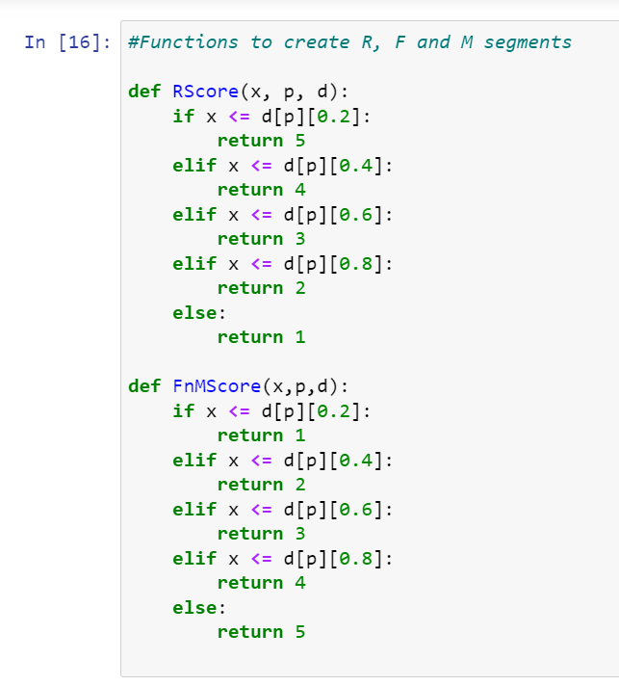
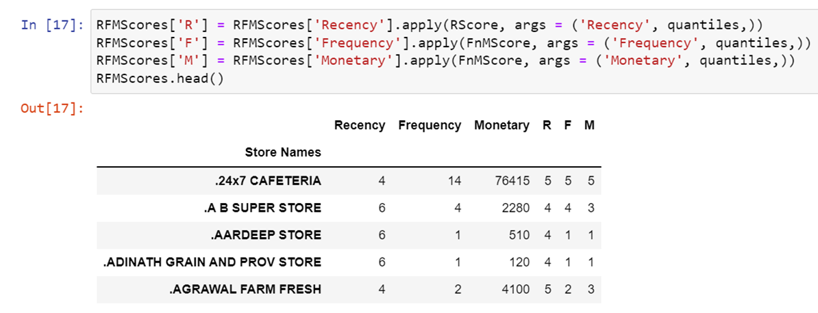
RFM Scores
For each and every store the R, F, and M scores are calculated using quantiles.

Slide 39
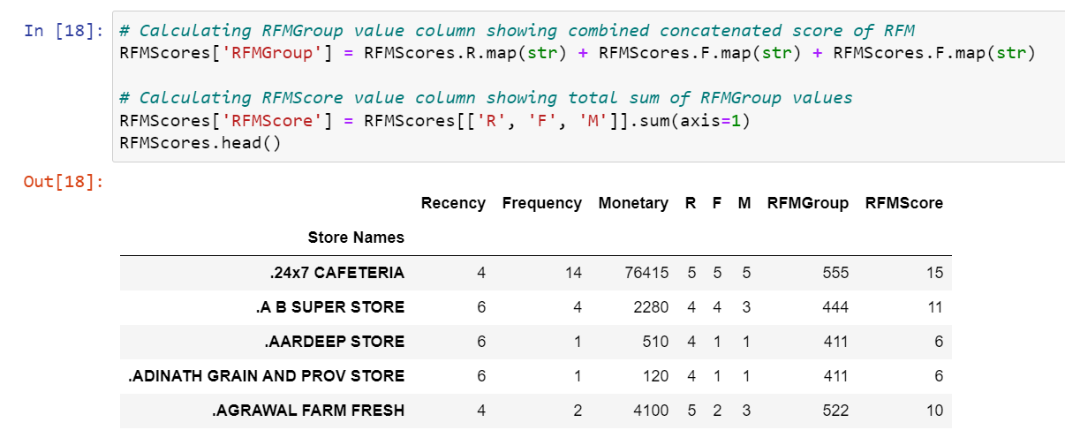
Grouping Customers
Best customers:
High ‘R’, High ‘F’ and High ‘M’
Customers who bought most recently, most often, and are heavy spenders.
At-Risk Customers:
Low ‘R’, ‘High F’ and High ‘M’
Customers who purchased often and spent big amounts, but haven’t purchased recently.
Lost Customers:
Low ‘R’ , Low ‘R’ and Low ‘M’
Customers with Low frequency and spending amount. Not placing an order recently.

Slide 40
K-Means Clustering

Slide 41
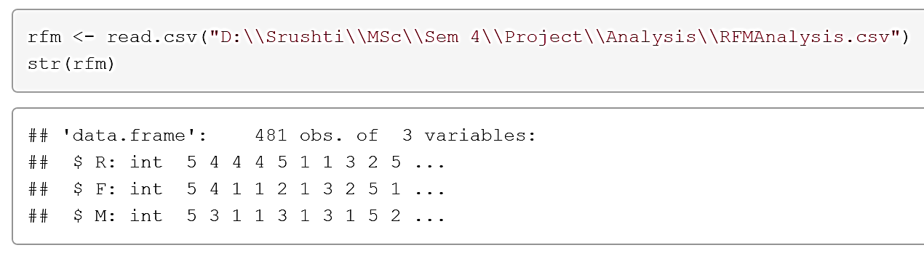
Importing the Data
Step 1: Importing required packages:
The packages ggplot2, factoextra, NbClust, and cluster are installed and called using library() function.
Step 2: Importing Dataset
The CSV file is imported and stored in a data frame object rfm.

Slide 42
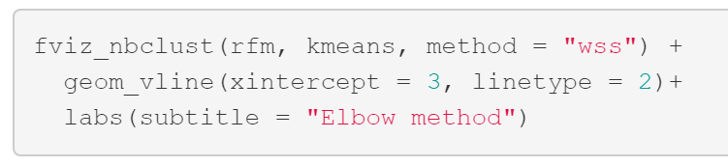
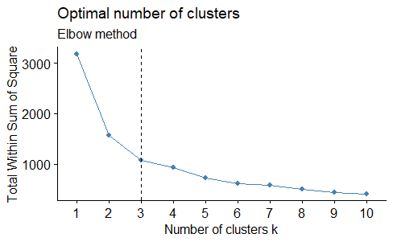
Choose Optimum ‘k’
Step 3: Selecting the optimal value of k. The k for k Means clustering is calculated using elbow method.
fviz_nbclust(): Determines and visualize the optimal number of clusters using different methods: within cluster sums of squares (WSS), average silhouette and gap statistics.
From this plot, Elbow is obtained at k=3, where the decrement in Total Within Sum of Squares after k=3 is insignificant, it does not worth to further complicate the model. So, we select k=3

Slide 43
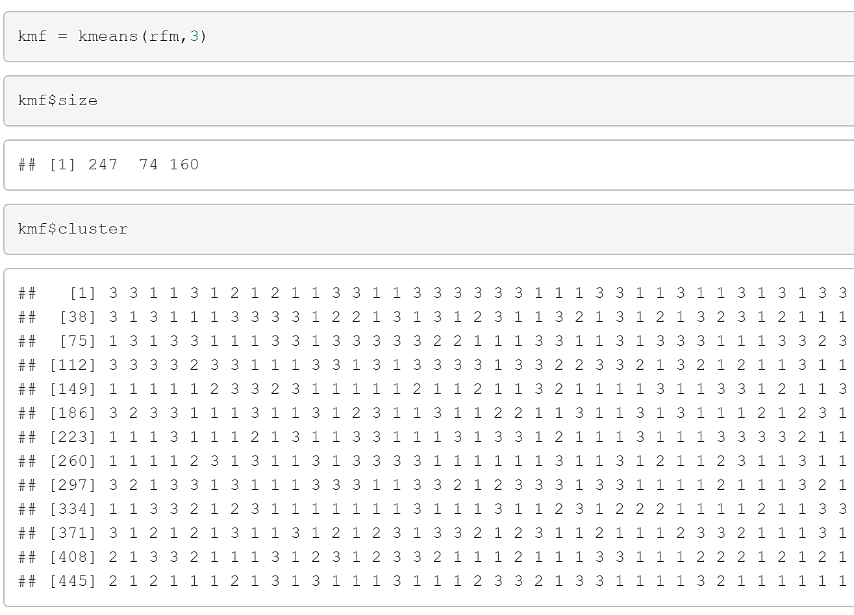
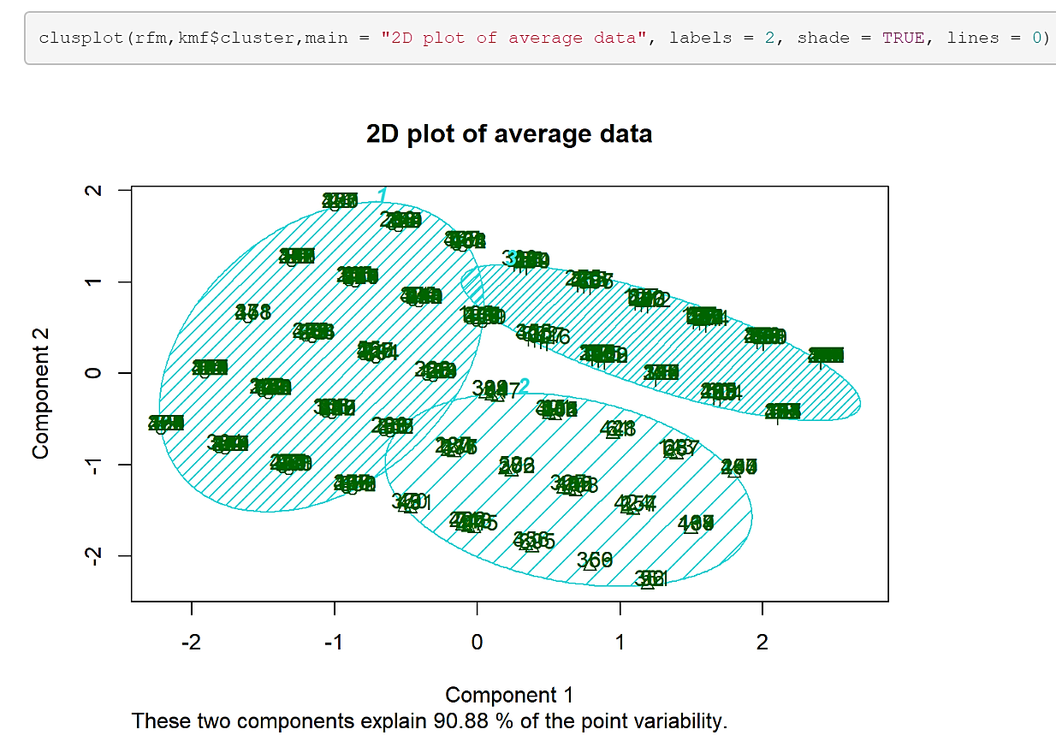
Visualizing Clusters
Step 4: Fitting the clustering model
Step 5: Visualizing the clusters using clustplot

Slide 44
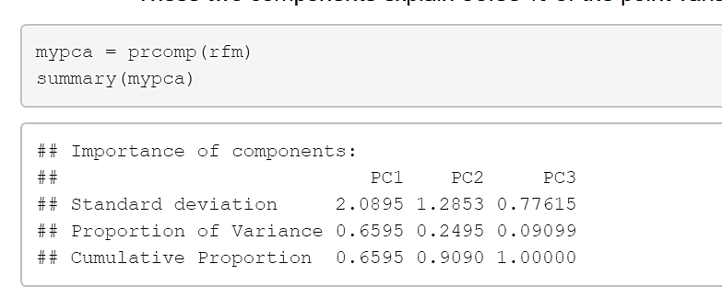
PCA at Backend
In this clustplot, PCA works on the backend.
Here, it can be concluded that 65.95% of the variation is explained by PC1 and 24.95% variation is explained by PC2. These 2 components are used to plot the clustplot. Thus, in the clustplot obtained, it is given that these 2 components explain 90.9% of the point variability.

Slide 45
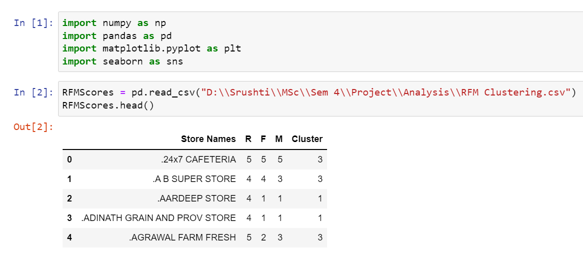
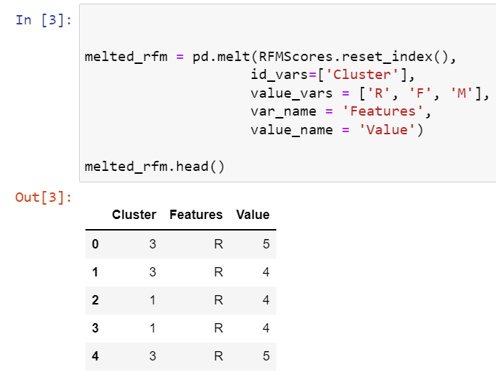
Basic Steps
Step 1: Importing Dataset in python
Step 2: Melted dataframe
Pandas.melt() unpivots a DataFrame from wide format to long format.

Slide 46
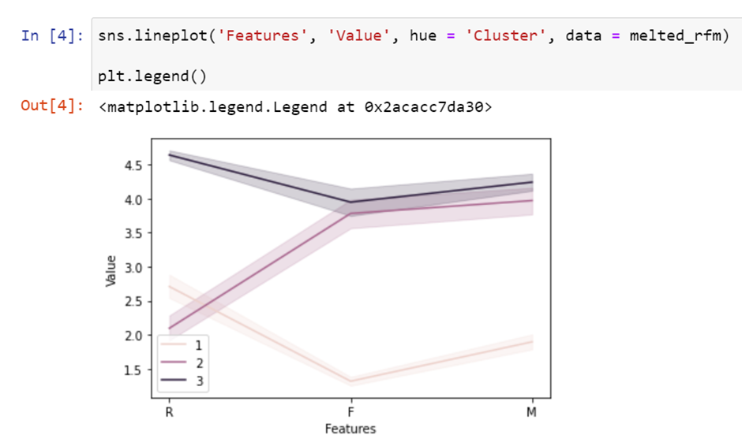
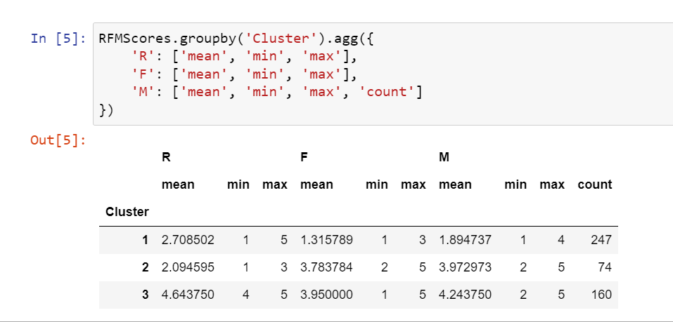
Line Plot for Clusters
Cluster 3:
Loyal customers: High ‘R’, High ‘F’ and High ‘M’
Customers who bought most recently, most often, and are heavy spenders.
Cluster 2:
At-Risk Customers: Low ‘R’, ‘High F’ and High ‘M’
Customers who purchased often and spent big amounts, but haven’t purchased recently.
Cluster 1:
Lost Customers: Low ‘R’, Low ‘R’, and Low ‘M’
Customers with Low frequency and spending amount. Not placed an order recently.

Slide 47
Interpretation of K-Means
Cluster | Customer Type | RFM Characteristics | Action
3 | Best/ Loyal Customers | Frequent and recent shoppers. Heavy spending | Potential to be target customers for newly launched products
2 | At risk of leaving Customers | Frequent and heavy-spent shoppers. It has been some time since the last purchase | Figuring out the reasons for leaving. Customized plans encouraging purchase again
1 | Lost Customers | Low frequency and spending amount and not placing an order recently | The business might have lost them. Finding out the reason for being churned. Improving the services to avoid further losing

Slide 48
Conclusions
The sales for Financial Year 2021-22 is the highest sales.
Mass Category (31%) is most sold category followed by Super Saver (23%) and Family Pack (21%).
Krishna Sales (17.83%) has the highest sales out of all stores followed by Raja Traders (13.59%) and Surya Palace (5.50%).
General Trade accounts for 51% of total Sales while Institutional Trade covers 49% of total Sales.
Choco Kiss is the highest selling product in General Trade and Institutional Trade.
Based on T-test , we concluded that there is no significant difference in sales of Old city and New City Route as well as in sales of Institutional Trade and General Trade.
7. According to RFM and K-Means Clustering analysis, we can group the customers into three segments:
Best customers: 160 Stores.
At-Risk Customers: 74 Stores
Lost Customers: 247 Stores

Slide 49
References
https://power.larc.nasa.gov/data-access-viewer/
https://vmc.gov.in/pdf/administation%20ward%20Final.pdf
A review of the application of rfm model
https://www.researchgate.net/publication/228399859_a_review_of_the_application_of_rfm_model
A study on fast moving consumer goods FMCG -with special reference to Kancheepuram district
https://www.researchgate.net/publication/338645176_retail_marketing_a_critical_analysis

Slide 50
THANK YOU

